Slide 1


Project 1: Netflix Genres Analysis
Georgia Tech Data Boot Camp: Group 1
Brian Hall | Daulton Davis | Hassan Mohamed
Joseph Johnson | Kelly Brown
Leon Lee | Orlvertta Moody
Valentina Zhu | Vedrana Basimamovic
This Photo by Unknown author is licensed under CC BY-ND.

Slide 2

Objective
Upper managements is concerned with a declining trend in subscriber count
Seeking answers on trends among four genres:
Action, Horror, Documentary, and Comedy.
Team is tasked with current content analysis among four genres using current Netflix data sets

Slide 3
Data set
Quantity of each genre (number of movies and shows)
Quality of each genre (IMDb average rating)
Most popular movie and/or show for the specific genre (TMDB)
Most featured actor/actress for the specific genre

Slide 4
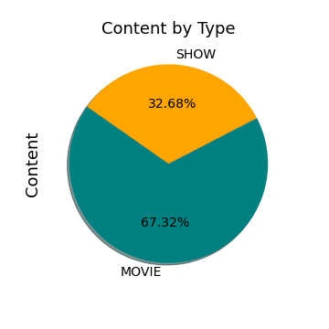
Data set
Release date from 1953 to 2022
Content by Type
Minimum IMDb score of 1.5 and max 9.5
TMDB Popularity score ranges from .6 to 1823.34
Notes:
TMDB – the movie database popularity score :
Number of votes for the day, views for the day, sers who marked it as a "favourite" for the day, users who added it to their "watchlist" for the day, release date, number of total votes, previous days score

Slide 5
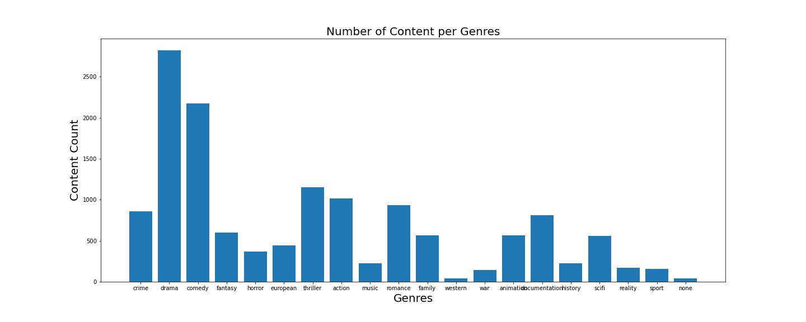
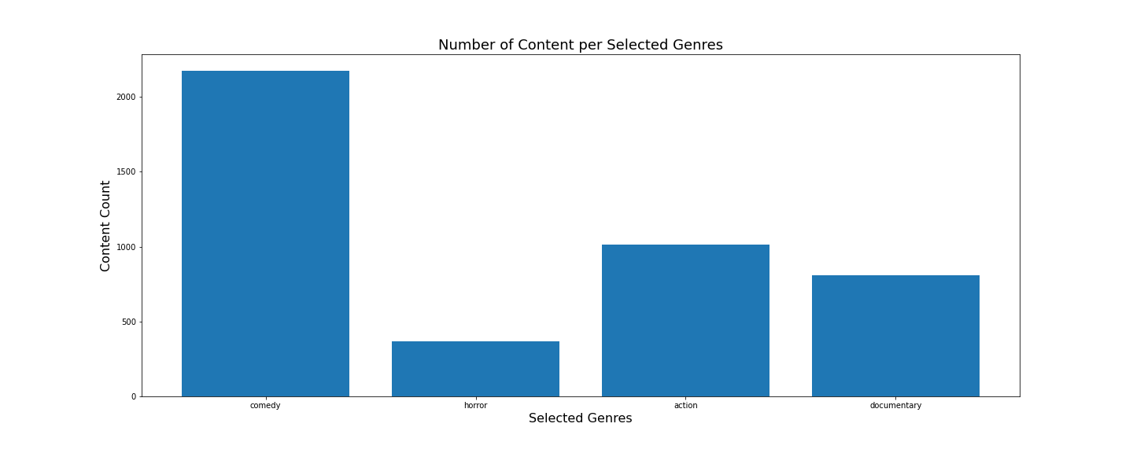
Top 5 genres:
Drama
Comedy
Thriller
Action
Romance
Selected Genres Count:
Comedy 40%
Horror 7%
Action 19%
Documentary 15%

Slide 6
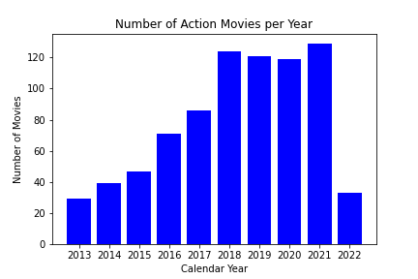
Action - Data set
The number of action movies on Netflix had a steady growth and then had it’s biggest jump in 2018.
The significant drop for 2022 was due to the timing of the data (partway through 2022), so not all movies were accounted for in 2022.
Notes:
TMDB – the movie database popularity score :
Number of votes for the day, views for the day, sers who marked it as a "favourite" for the day, users who added it to their "watchlist" for the day, release date, number of total votes, previous days score

Slide 7
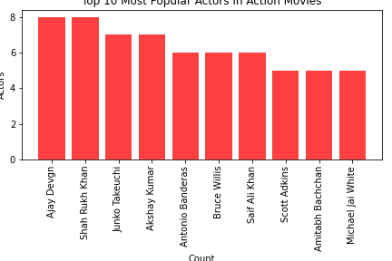
Action - Data set
The most featured actors/actresses in action movies are international actors/actresses, which could represent Netflix’s desire to incorporate more international films.
There will have to be more data munging to figure if this is the case.
Notes:
TMDB – the movie database popularity score :
Number of votes for the day, views for the day, sers who marked it as a "favourite" for the day, users who added it to their "watchlist" for the day, release date, number of total votes, previous days score

Slide 8
Comedy Data set
Notes:
TMDB – the movie database popularity score :
Number of votes for the day, views for the day, sers who marked it as a "favourite" for the day, users who added it to their "watchlist" for the day, release date, number of total votes, previous days score

Slide 9
Horror Data set
Notes:
TMDB – the movie database popularity score :
Number of votes for the day, views for the day, sers who marked it as a "favourite" for the day, users who added it to their "watchlist" for the day, release date, number of total votes, previous days score

Slide 10
Documentary Data set
Notes:
TMDB – the movie database popularity score :
Number of votes for the day, views for the day, sers who marked it as a "favourite" for the day, users who added it to their "watchlist" for the day, release date, number of total votes, previous days score

Slide 11
recommendations
Notes:
TMDB – the movie database popularity score :
Number of votes for the day, views for the day, sers who marked it as a "favourite" for the day, users who added it to their "watchlist" for the day, release date, number of total votes, previous days score

